Slide 1
Dynamic Programming
By: Ashok Basnet

Slide 2
Course Outline
Dynamic Programming
Multistage Graphs
All Pair Shortest Paths
Single Source Shortest Path: General Weights
Optimal Binary Search Trees
String Editing Problem
0/1-Knapsack Problem
Reliability Design
TSP

Slide 3
Dynamic Programming
Dynamic programming is a name, coined by Richard Bellman in 1955.
Dynamic programming, as greedy method, is a powerful algorithm design technique that can be used when the solution to the problem may be viewed as the result of a sequence of decisions.
In the greedy method we make irrevocable decisions one at a time, using a greedy criterion.
However, in dynamic programming we examine the decision sequence to see whether an optimal decision sequence contains optimal decision subsequence.
When optimal decision sequences contain optimal decision subsequences, we can establish recurrence equations, called dynamic-programming recurrence equations, that enable us to solve the problem in an efficient way.

Slide 4
Dynamic Programming
Dynamic programming is based on the principle of optimality.
The principle of optimality states that no matter whatever the initial state and initial decision are, the remaining decision sequence must constitute an optimal decision sequence with regard to the state resulting from the first decision.
The principle implies that an optimal decision sequence is comprised of optimal decision subsequences.
Since the principle of optimality may not hold for some formulations of some problems, it is necessary to verify that it does hold for the problem being solved.
Dynamic programming cannot be applied when this principle does not hold.

Slide 5
Dynamic Programming
The steps in a dynamic programming solution are:
Verify that the principle of optimality holds
Set up the dynamic-programming recurrence equations
Solve the dynamic-programming recurrence equations for the value of the optimal solution.
Perform a trace back step in which the solution itself is constructed.
Dynamic programming differs from the greedy method since the greedy method produces only one feasible solution, which may or may not be optimal, while dynamic programming produces all possible sub-problems at most once, one of which guaranteed to be optimal.
Optimal solutions to sub-problems are retained in a table, thereby avoiding the work of recomputing the answer every time a sub-problem is encountered.

Slide 6
Dynamic Programming
The divide and conquer principle solve a large problem, by breaking it up into smaller problems which can be solved independently.
In dynamic programming this principle is carried to an extreme: when we don't know exactly which smaller problems to solve, we simply solve them all, then store the answers away in a table to be used later in solving larger problems.
Care is to be taken to avoid recomputing previously computed values, otherwise the recursive program will have prohibitive complexity.
In some cases, the solution can be improved and in other cases, the dynamic programming technique is the best approach.

Slide 7
Dynamic Programming
Two difficulties may arise in any application of dynamic programming:
It may not always be possible to combine the solutions of smaller problems to form the solution of a larger one.
The number of small problems to solve may be un-acceptably large.
There is no characterized precisely which problems can be effectively solved with dynamic programming; there are many hard problems for which it does not seen to be applicable, as well as many easy problems for which it is less efficient than standard algorithms.

Slide 8
Multi Stage Graphs
A multistage graph G = (V, E) is a directed graph in which the vertices are partitioned into k ≥ 2 disjoint sets V_{i} , 1 ≤ i ≤ k. In addition, if <u, v> is an edge in E, then u ∈ V_{i} and v ∈ V_{i+1} for some i, 1 ≤ i ≤ k.
Let the vertex ‘s’ is the source, and ‘t’ the sink. Let c (i, j) be the cost of edge <i, j>.
The cost of a path from ‘s’ to ‘t’ is the sum of the costs of the edges on the path.
The multistage graph problem is to find a minimum cost path from ‘s’ to ‘t’.
Each set V_{i} defines a stage in the graph. Because of the constraints on E, every path from ‘s’ to ‘t’ starts in stage 1, goes to stage 2, then to stage 3, then to stage 4, and so on, and eventually terminates in stage k.

Slide 9
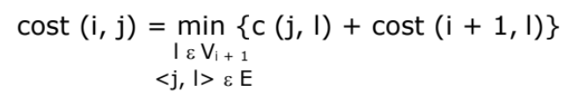
Multi Stage Graphs
A dynamic programming formulation for a k-stage graph problem is obtained by first noticing that every s to t path is the result of a sequence of k – 2 decisions.
Let c (i, j) be the cost of the path from source to destination and cost(i, j) = cost(stage, vertex). Then using the forward approach, we obtain:

Slide 10
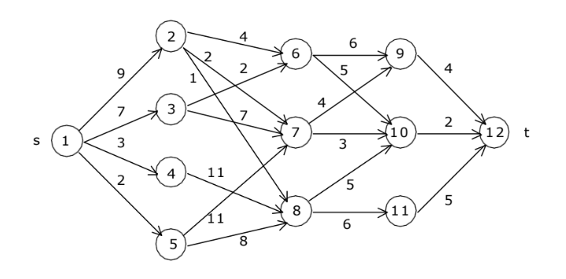
Multi Stage Graphs

Slide 11
Multi Stage Graphs
Cost can be represented as: cost(stage_number, vertext_number)
V | 1 | 2 | 3 | 4 | 5 | 6 | 7 | 8 | 9 | 10 | 11 | 12
cost
d

Slide 12
Multi Stage Graphs
For fifth stage
Cost(5, 12) = 0
V | 1 | 2 | 3 | 4 | 5 | 6 | 7 | 8 | 9 | 10 | 11 | 12
cost |  |  |  |  |  |  |  |  |  |  |  | 0
d |  |  |  |  |  |  |  |  |  |  |  | 12

Slide 13
Multi Stage Graphs
for fourth stage
Cost(4, 9) = 4
Cost(4, 10) = 2
Cost(4, 11) = 5
V | 1 | 2 | 3 | 4 | 5 | 6 | 7 | 8 | 9 | 10 | 11 | 12
cost |  |  |  |  |  |  |  |  | 4 | 2 | 5 | 0
d |  |  |  |  |  |  |  |  | 12 | 12 | 12 | 12

Slide 14
Multi Stage Graphs
for third stage
Cost(3, 6) = min{ c(6,9) + cost(4, 9), c(6, 10) + cost(4, 10) }
= min { 6+4, 5+2 } = 7
V | 1 | 2 | 3 | 4 | 5 | 6 | 7 | 8 | 9 | 10 | 11 | 12
cost |  |  |  |  |  | 7 |  |  | 4 | 2 | 5 | 0
d |  |  |  |  |  | 10 |  |  | 12 | 12 | 12 | 12

Slide 15
Multi Stage Graphs
for third stage
Cost(3, 6) = min{ c(6,9) + cost(4, 9), c(6, 10) + cost(4, 10) }
= min { 6+4, 5+2 } = 7
Cost(3, 7) = min{ c(7,9) + cost(4, 9) , c(7, 10) + cost(4, 10) }
= min{ 4 + 4, 3 + 2 } = 5
V | 1 | 2 | 3 | 4 | 5 | 6 | 7 | 8 | 9 | 10 | 11 | 12
cost |  |  |  |  |  | 7 | 5 |  | 4 | 2 | 5 | 0
d |  |  |  |  |  | 10 | 10 |  | 12 | 12 | 12 | 12

Slide 16
Multi Stage Graphs
for third stage
Cost(3, 6) = min{ c(6,9) + cost(4, 9), c(6, 10) + cost(4, 10) }
= min { 6+4, 5+2 } = 7
Cost(3, 7) = min{ c(7,9) + cost(4, 9) , c(7, 10) + cost(4, 10) }
= min{ 4 + 4, 3 + 2 } = 5
Cost(3, 8) = min { c(8, 10) + cost ( 4, 10) , c(8, 11) + cost(4, 11)
= min { 5+2, 6+5 } = 7
V | 1 | 2 | 3 | 4 | 5 | 6 | 7 | 8 | 9 | 10 | 11 | 12
cost |  |  |  |  |  | 7 | 5 | 7 | 4 | 2 | 5 | 0
d |  |  |  |  |  | 10 | 10 | 10 | 12 | 12 | 12 | 12

Slide 17
Multi Stage Graphs
For second stage
Cost(2, 2) = min{ c(2, 6) + cost (3, 6), c(2, 7) + cost(3, 7), c(2, 8) + cost(3, 8) }
= { 4+7, 2+5, 1+7 } = 7
V | 1 | 2 | 3 | 4 | 5 | 6 | 7 | 8 | 9 | 10 | 11 | 12
cost |  | 7 |  |  |  | 7 | 5 | 7 | 4 | 2 | 5 | 0
d |  | 7 |  |  |  | 10 | 10 | 10 | 12 | 12 | 12 | 12

Slide 18
Multi Stage Graphs
for second stage
Cost(2, 2) = min{ c(2, 6) + cost (3, 6), c(2, 7) + cost(3, 7), c(2, 8) + cost(3, 8) }
= { 4+7, 2+5, 1+7 } = 7
Cost(2, 3) = min{ c(3, 6) + cost (3, 6), c(3, 7) + cost(3, 7) }
= { 2+7, 7+5 } = 9
V | 1 | 2 | 3 | 4 | 5 | 6 | 7 | 8 | 9 | 10 | 11 | 12
cost |  | 7 | 9 |  |  | 7 | 5 | 7 | 4 | 2 | 5 | 0
d |  | 7 | 6 |  |  | 10 | 10 | 10 | 12 | 12 | 12 | 12

Slide 19
Multi Stage Graphs
for second stage
Cost(2, 2) = min{ c(2, 6) + cost (3, 6), c(2, 7) + cost(3, 7), c(2, 8) + cost(3, 8) }
= { 4+7, 2+5, 1+7 } = 7
Cost(2, 3) = min{ c(3, 6) + cost (3, 6), c(3, 7) + cost(3, 7) }
= { 2+7, 7+5 } = 9
Cost(2, 4) = min{ c(4, 8) + cost (3, 8) }
= { 11+7 } = 18
V | 1 | 2 | 3 | 4 | 5 | 6 | 7 | 8 | 9 | 10 | 11 | 12
cost |  | 7 | 9 | 18 |  | 7 | 5 | 7 | 4 | 2 | 5 | 0
d |  | 7 | 6 | 8 |  | 10 | 10 | 10 | 12 | 12 | 12 | 12

Slide 20
Multi Stage Graphs
for second stage
Cost(2, 2) = min{ c(2, 6) + cost (3, 6), c(2, 7) + cost(3, 7), c(2, 8) + cost(3, 8) }
= { 4+7, 2+5, 1+7 } = 7
Cost(2, 3) = min{ c(3, 6) + cost (3, 6), c(3, 7) + cost(3, 7) }
= { 2+7, 7+5 } = 9
Cost(2, 4) = min{ c(4, 8) + cost (3, 8) }
= { 11+7 } = 18
Cost(2, 5) = min{ c(5, 7) + cost (3, 7), c(5, 8) + cost(3, 8) }
= { 11+5, 8+7 } = 15
V | 1 | 2 | 3 | 4 | 5 | 6 | 7 | 8 | 9 | 10 | 11 | 12
cost |  | 7 | 9 | 18 | 15 | 7 | 5 | 7 | 4 | 2 | 5 | 0
d |  | 7 | 6 | 8 | 8 | 10 | 10 | 10 | 12 | 12 | 12 | 12

Slide 21
Multi Stage Graphs
for first stage
Cost(1, 1) = min{ c(1,2) + cost(2, 2), c(1, 3) + cost(2, 3), c(1, 4) + cost(2, 4), c(1, 5) + cost(2, 5) }
= min{ 9+7, 7+9, 3+18, 2+15 } = min(16, 16, 21, 17)
V | 1 | 2 | 3 | 4 | 5 | 6 | 7 | 8 | 9 | 10 | 11 | 12
cost | 16 | 7 | 9 | 18 | 15 | 7 | 5 | 7 | 4 | 2 | 5 | 0
d | 2 or 3 | 7 | 6 | 8 | 8 | 10 | 10 | 10 | 12 | 12 | 12 | 12

Slide 22
Multi Stage Graphs
V | 1 | 2 | 3 | 4 | 5 | 6 | 7 | 8 | 9 | 10 | 11 | 12
cost | 16 | 7 | 9 | 18 | 15 | 7 | 5 | 7 | 4 | 2 | 5 | 0
d | 2 or 3 | 7 | 6 | 8 | 8 | 10 | 10 | 10 | 12 | 12 | 12 | 12
We have complete data. Now we can implement the dynamic programming to make decision.
For forward approach, we will move from source to sink.
d(stage, vertex) = d(1, 1) = 2
d(2, 2) = 7
d(3, 7) = 10
d(4, 10) = 12
Path = 1, 2, 7, 10, 12

Slide 23
Multi Stage Graphs
We have complete data. Now we can implement the dynamic programming to make decision.
For forward approach, we will move from source to sink.
d(stage, vertex) = d(1, 1) = 3
d(2, 3) = 6
d(3, 6) = 10
d(4, 10) = 12
Path = 1, 3, 6, 10, 12
V | 1 | 2 | 3 | 4 | 5 | 6 | 7 | 8 | 9 | 10 | 11 | 12
cost | 16 | 7 | 9 | 18 | 15 | 7 | 5 | 7 | 4 | 2 | 5 | 0
d | 2 or 3 | 7 | 6 | 8 | 8 | 10 | 10 | 10 | 12 | 12 | 12 | 12

Slide 24
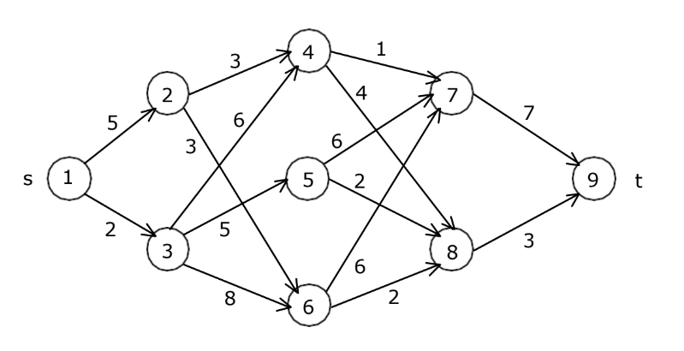
Multi Stage Graphs

Slide 25
Algorithm for Multistage Graph (Shortest Path):
Initialization:
Create a table to store the optimal costs for each node in each stage.
Initialize the last stage's costs as the weights of the corresponding nodes.
Bottom-Up Computation:
Starting from the penultimate stage and moving backward, compute the optimal costs for each node in each stage based on the optimal costs of the next stage.
Use the following recurrence relation for each node in a stage i:
cost[i] = min(weight(i, j) + cost[j]) for all j in the next stage
Here, weight(i, j) represents the weight of the edge from node i to node j.
Traceback:
After completing the bottom-up computation, the optimal cost of the starting node is obtained.
Trace back through the computed costs to reconstruct the optimal path.
Optimal Solution:
The optimal solution is the path from the starting node to the ending node with the minimum total cost.

Slide 26
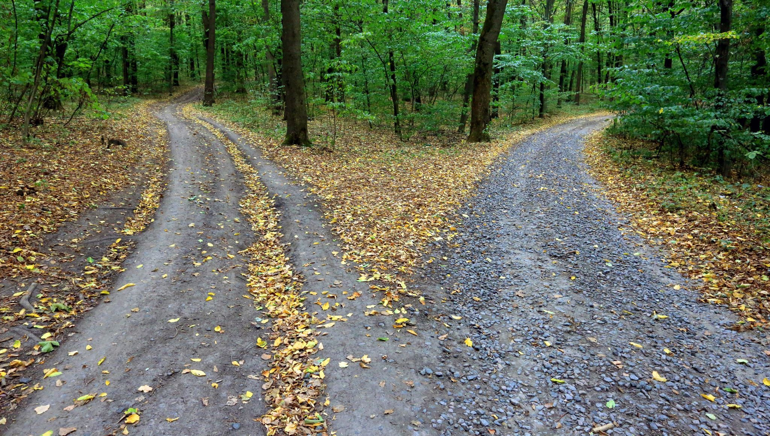
All pairs shortest paths

Slide 27
All pairs shortest paths (Floyd-Warshall)
In the all pairs shortest path problem, we are to find a shortest path between every pair of vertices in a directed graph G.
That is, for every pair of vertices (i, j), we are to find a shortest path from i to j as well as one from j to i.
These two paths are the same when G is undirected.
The all pairs shortest path problem is to determine a matrix A such that A (i, j) is the length of a shortest path from i to j.
The matrix A can be obtained by solving n single-source problems using the algorithm shortest Paths.

Slide 28
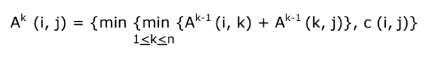
All pairs shortest paths
The shortest i to j path in G, i ≠ j originates at vertex i and goes through some intermediate vertices (possibly none) and terminates at vertex j.
If k is an intermediate vertex on this shortest path, then the sub paths from i to k and from k to j must be shortest paths from i to k and k to j, respectively.
Otherwise, the i to j path is not of minimum length. So, the principle of optimality holds.
Let A^{k} (i, j) represent the length of a shortest path from i to j going through no vertex of index greater than k, we obtain:

Slide 29
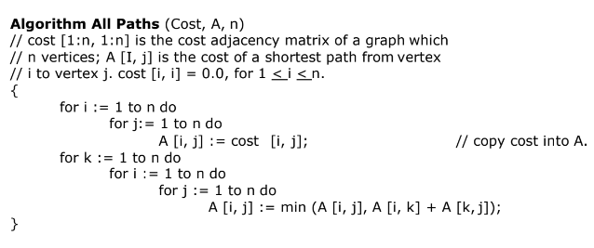
All pairs shortest paths

Slide 30
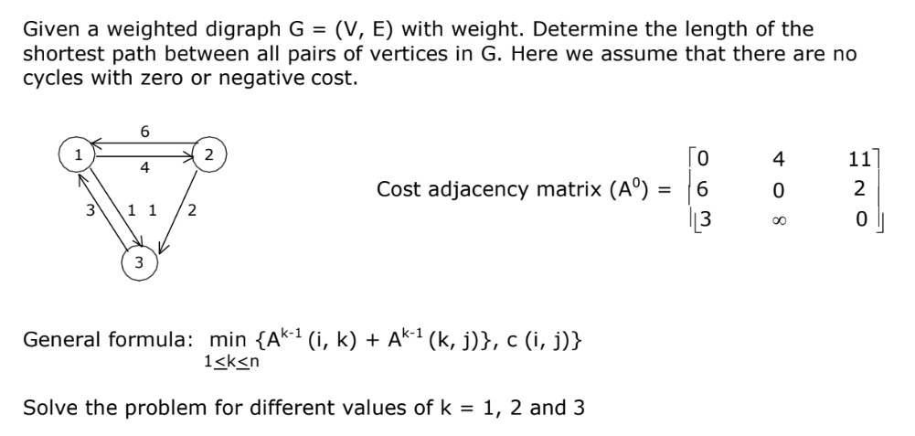
All pairs shortest paths

Slide 31
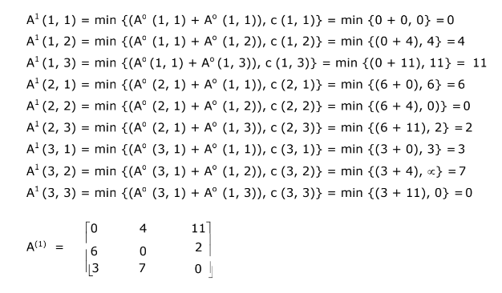
All pairs shortest paths

Slide 32
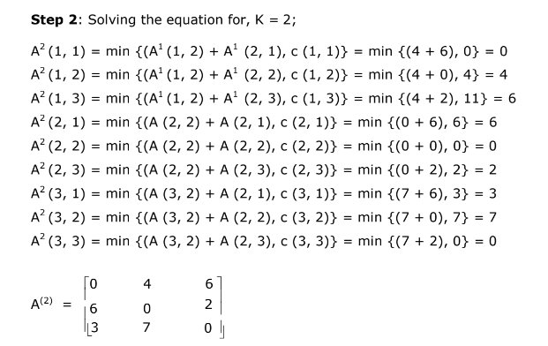
All pairs shortest paths

Slide 33
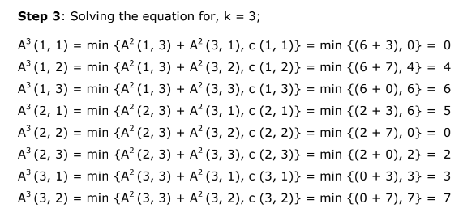
All pairs shortest paths

Slide 34
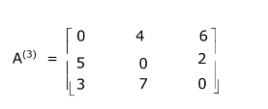
All pairs shortest paths

Slide 35
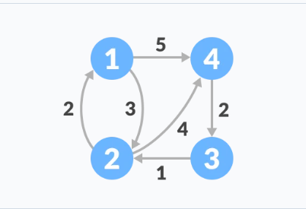
All pairs shortest paths

Slide 36
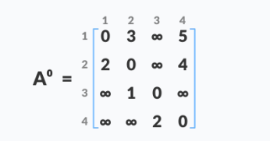
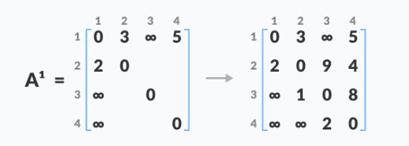
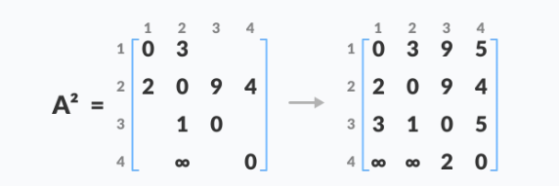
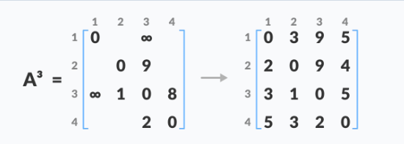
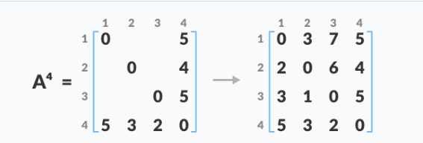

Slide 37
Single Source Shortest Path: General Weights (Bellman Ford Algorithm)
The Single-Source Shortest Path (SSSP) algorithm is used to find the shortest paths from a single source vertex to all other vertices in a weighted graph.
There are several algorithms to solve this problem, and two of the most commonly used ones are Dijkstra's algorithm and Bellman-Ford algorithm.
Given a graph and a source vertex src in the graph, find the shortest paths from src to all vertices in the given graph. The graph may contain negative weight edges.
Dijkstra doesn’t work for Graphs with negative weights, Bellman-Ford works for such graphs.
Bellman-Ford is also simpler than Dijkstra and suites well for distributed systems.

Slide 38
Initialization:
Create an array dist[] to store the shortest distances from the source to each vertex.
Initialize dist[] with infinity for all vertices except the source, and set dist[source] to 0.
Relaxation Loop:
Iterate |V| - 1 times, where |V| is the number of vertices.
For each edge (u, v) in the graph, check if the distance from the source to v can be shortened by going through u.
If dist[u] + weight(u, v) < dist[v], update dist[v] with the new, shorter distance.
Negative Cycle Check:
After the relaxation loop, check for the presence of negative cycles.
If there is a vertex v such that dist[u] + weight(u, v) < dist[v], then the graph contains a negative cycle.
Result:
The final distances in the dist[] array represent the shortest paths from the source to all other vertices, or the presence of a negative cycle is detected.

Slide 39
function BellmanFord(graph, source):
create an array dist[] to store the shortest distances
initialize dist[] with infinity for all vertices except the source
set distance[source] to 0
for i from 1 to |V| - 1:
for each edge (u, v) in graph:
alt = dist[u] + weight(u, v)
if alt < dist[v]:
dist[v] = alt
for each edge (u, v) in graph:
if dist[u] + weight(u, v) < dist[v]:
raise Error("Graph contains a negative cycle")
return dist

Slide 40
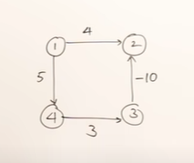
Problem 1

Slide 41
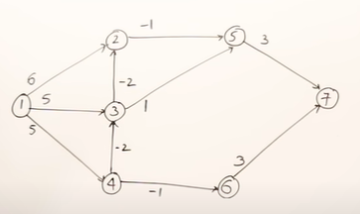
Problem 2
Let the given source vertex be 1. Initialize all distances as infinite, except the distance to the source itself. Total number of vertices in the graph is 7, so all edges must be processed 6 times.

Slide 42
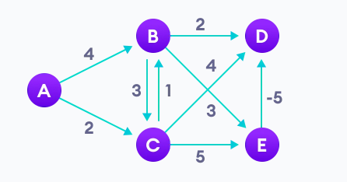
Problem 3

Slide 43
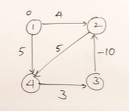
Problem 4

Slide 44

0/1 - Knapsack Problem

Slide 45
0/1 - Knapsack Problem
Knapsack Problem algorithm is a very helpful problem in combinatorics. In the supermarket there are n packages (n ≤ 100) the package i has weight W[i] ≤ 100 and value V[i] ≤ 100. A thief breaks into the supermarket, the thief cannot carry weight exceeding M (M ≤ 10).
The problem to be solved here is: which packages the thief will take away to get the highest value?
Input
Maximum weight M and the number of packages n.
Array of weight W[i] and corresponding value V[i].
Output:
Maximize value and corresponding weight in capacity.
Which packages the thief will take away.

Slide 46
0/1 - Knapsack Problem
The 0/1 Knapsack problem using dynamic programming. In this Knapsack algorithm type, each package can be taken or not taken. Besides, the thief cannot take a fractional amount of a taken package or take a package more than once. This type can be solved by Dynamic Programming Approach.
The basic idea of Knapsack dynamic programming is to use a table to store the solutions of solved subproblems.
When analyzing 0/1 Knapsack problem using Dynamic programming, you can find some noticeable points.
The value of the knapsack algorithm depends on two factors:
How many packages are being considered?
The remaining weight which the knapsack can store?

Slide 47
0/1 - Knapsack Problem
Therefore, you have two variable quantities. With dynamic programming, you have useful information:
the objective function will depend on two variable quantities
the table of options will be a 2-dimensional table.
If calling B[i][j] is the maximum possible value by selecting in packages {1, 2, …, i} with weight limit j.
The maximum value when selected in n packages with the weight limit M is B[n][M]. In other words: When there are i packages to choose, B[i][j] is the optimal weight when the maximum weight of the knapsack is j.
The optimal weight is always less than or equal to the maximum weight: B[i][j] ≤ j.

Slide 48
0/1 - Knapsack Problem
For example: B[4][10] = 8. It means that in the optimal case, the total weight of the selected packages is 8, when there are 4 first packages to choose from (1st to 4th package) and the maximum weight of the knapsack is 10. It is not necessary that all 4 items are selected.
W[i], V[i] are in turn the weight and value of package i, in which i ∈ {1, …, n}.
M is the maximum weight that the knapsack can carry.
If ( j < wt[ i ] ) :
B[i][j] = B[i – 1][j]
Else :
B[i][j]= max(V[i]+B[i – 1][j – W[i]], B[i – 1][j])

Slide 49
0/1 - Knapsack Problem
Let's say we have 4 items and a knapsack of capacity 7.
Hence, m = 7
Weight | 1 | 3 | 4 | 5
Value | 1 | 4 | 5 | 7

Slide 50
0/1 - Knapsack Problem
Weight | 1 | 3 | 4 | 5
Value | 1 | 4 | 5 | 7
V | Wt. | 0 | 1 | 2 | 3 | 4 | 5 | 6 | 7
0 | 0 | 0 | 0 | 0 | 0 | 0 | 0 | 0 | 0
1 | 1 | 0
4 | 3 | 0
5 | 4 | 0
7 | 5 | 0

Slide 51
0/1 - Knapsack Problem
V | Wt. |  | j = 0 | 1 | 2 | 3 | 4 | 5 | 6 | 7
0 | 0 | i = 0 | 0 | 0 | 0 | 0 | 0 | 0 | 0 | 0
1 | 1 | 1 | 0 | 1
4 | 3 | 2 | 0
5 | 4 | 3 | 0
7 | 5 | 4 | 0
Here, B[i][j]= max(V[i]+B[i – 1][j – W[i]], B[i – 1][j])
B[1][1] = max(1+B[0][0], B[0][1])
B[1][1] = max(1, 0) = 1

Slide 52
0/1 - Knapsack Problem
V | Wt. |  | j = 0 | 1 | 2 | 3 | 4 | 5 | 6 | 7
0 | 0 | i = 0 | 0 | 0 | 0 | 0 | 0 | 0 | 0 | 0
1 | 1 | 1 | 0 | 1 | 1 | 1 | 1 | 1 | 1 | 1
4 | 3 | 2 | 0
5 | 4 | 3 | 0
7 | 5 | 4 | 0

Slide 53
0/1 - Knapsack Problem
V | Wt. |  | j = 0 | 1 | 2 | 3 | 4 | 5 | 6 | 7
0 | 0 | i = 0 | 0 | 0 | 0 | 0 | 0 | 0 | 0 | 0
1 | 1 | 1 | 0 | 1 | 1 | 1 | 1 | 1 | 1 | 1
4 | 3 | 2 | 0 | 1 | 1
5 | 4 | 3 | 0
7 | 5 | 4 | 0

Slide 54
0/1 - Knapsack Problem
V | Wt. |  | j = 0 | 1 | 2 | 3 | 4 | 5 | 6 | 7
0 | 0 | i = 0 | 0 | 0 | 0 | 0 | 0 | 0 | 0 | 0
1 | 1 | 1 | 0 | 1 | 1 | 1 | 1 | 1 | 1 | 1
4 | 3 | 2 | 0 | 1 | 1
5 | 4 | 3 | 0
7 | 5 | 4 | 0
Here, B[i][j]= max(V[i]+B[i – 1][j – W[i]], B[i – 1][j])
B[2][3] = max(4+B[1][0], B[1][3])
B[2][3] = max(4+0, 1) = 4

Slide 55
0/1 - Knapsack Problem
V | Wt. |  | j = 0 | 1 | 2 | 3 | 4 | 5 | 6 | 7
0 | 0 | i = 0 | 0 | 0 | 0 | 0 | 0 | 0 | 0 | 0
1 | 1 | 1 | 0 | 1 | 1 | 1 | 1 | 1 | 1 | 1
4 | 3 | 2 | 0 | 1 | 1 | 4
5 | 4 | 3 | 0
7 | 5 | 4 | 0
Here, B[i][j]= max(V[i]+B[i – 1][j – W[i]], B[i – 1][j])
B[2][3] = max(4+B[1][0], B[1][3])
B[2][3] = max(4+0, 1) = 4

Slide 56
0/1 - Knapsack Problem
V | Wt. |  | j = 0 | 1 | 2 | 3 | 4 | 5 | 6 | 7
0 | 0 | i = 0 | 0 | 0 | 0 | 0 | 0 | 0 | 0 | 0
1 | 1 | 1 | 0 | 1 | 1 | 1 | 1 | 1 | 1 | 1
4 | 3 | 2 | 0 | 1 | 1 | 4 | 5
5 | 4 | 3 | 0
7 | 5 | 4 | 0
Here, B[i][j]= max(V[i]+B[i – 1][j – W[i]], B[i – 1][j])
B[2][4] = max(4+B[1][1], B[1][4])
B[2][3] = max(4+1, 1) = 5

Slide 57
0/1 - Knapsack Problem
V | Wt. |  | j = 0 | 1 | 2 | 3 | 4 | 5 | 6 | 7
0 | 0 | i = 0 | 0 | 0 | 0 | 0 | 0 | 0 | 0 | 0
1 | 1 | 1 | 0 | 1 | 1 | 1 | 1 | 1 | 1 | 1
4 | 3 | 2 | 0 | 1 | 1 | 4 | 5 | 5 | 5 | 5
5 | 4 | 3 | 0
7 | 5 | 4 | 0

Slide 58
0/1 - Knapsack Problem
V | Wt. |  | j = 0 | 1 | 2 | 3 | 4 | 5 | 6 | 7
0 | 0 | i = 0 | 0 | 0 | 0 | 0 | 0 | 0 | 0 | 0
1 | 1 | 1 | 0 | 1 | 1 | 1 | 1 | 1 | 1 | 1
4 | 3 | 2 | 0 | 1 | 1 | 4 | 5 | 5 | 5 | 5
5 | 4 | 3 | 0 | 1 | 1 | 4 | 5
7 | 5 | 4 | 0
Here, B[i][j]= max(V[i]+B[i – 1][j – W[i]], B[i – 1][j])
B[4][4] = max(5+B[2][0], B[2][4])
B[2][3] = max(5+0, 4) = 5

Slide 59
0/1 - Knapsack Problem
V | Wt. |  | j = 0 | 1 | 2 | 3 | 4 | 5 | 6 | 7
0 | 0 | i = 0 | 0 | 0 | 0 | 0 | 0 | 0 | 0 | 0
1 | 1 | 1 | 0 | 1 | 1 | 1 | 1 | 1 | 1 | 1
4 | 3 | 2 | 0 | 1 | 1 | 4 | 4 | 4 | 4 | 4
5 | 4 | 3 | 0 | 1 | 1 | 4 | 5 | 6 | 6 | 9
7 | 5 | 4 | 0 | 1 | 1 | 4 | 5 | 7 | 8 | 9

Slide 60
0/1 - Knapsack Problem
V | Wt. |  | j = 0 | 1 | 2 | 3 | 4 | 5 | 6 | 7
0 | 0 | i = 0 | 0 | 0 | 0 | 0 | 0 | 0 | 0 | 0
1 | 1 | 1 | 0 | 1 | 1 | 1 | 1 | 1 | 1 | 1
4 | 3 | 2 | 0 | 1 | 1 | 4 | 4 | 4 | 4 | 4
5 | 4 | 3 | 0 | 1 | 1 | 4 | 5 | 6 | 6 | 9
7 | 5 | 4 | 0 | 1 | 1 | 4 | 5 | 7 | 8 | 9
9 is the highest value we can get.
It's coming from 3rd row to 4th row.
So, we select the 3rd row with weight 4 and value 5.
Now, the weight of 4kg is full, so we take 2nd row and 3rd column. It has value of 4 and coming from same row.
So, we take second column with weight 3 and value 4.

Slide 61
0/1 - Knapsack Problem
Let's say we have 4 items and a knapsack of capacity 8.
Solve given problem.
Weight | 2 | 3 | 4 | 5
Value | 1 | 2 | 5 | 6

Slide 62
0/1 - Knapsack Problem
Weight | 2 | 3 | 4 | 5
Value | 1 | 2 | 5 | 6
Value | Wt |  | J = 0 | 1 | 2 | 3 | 4 | 5 | 6 | 7 | 8
0 | 0 | i = 0 | 0 | 0 | 0 | 0 | 0 | 0 | 0 | 0 | 0
1 | 2 | 1 | 0 | 0 | 1 | 1 | 1 | 1 | 1 | 1 | 1
2 | 3 | 2 | 0 | 0 | 1 | 2 | 2 | 3 | 3 | 3 | 3
5 | 4 | 3 | 0 | 0 | 1 | 2 | 5 | 5 | 6 | 7 | 7
6 | 5 | 4 | 0 | 0 | 1 | 2 | 5 | 6 | 6 | 7 | 8

Slide 63
String Editing Problem
The String Editing Problem, also known as the Edit Distance or Levenshtein Distance problem, involves determining the minimum number of operations required to transform one string into another.
The allowed operations typically include insertion, deletion, and substitution of characters.
The goal is to find the minimum cost or number of operations needed to make the two strings identical.
Example:
Convert azced to abcdef
Let's create a matrix to solve the String Editing Problem (Edit Distance problem) using dynamic programming.

Slide 64
String Editing Problem
 | Null | a | b | c | d | e | f
Null | 0 | 1 | 2 | 3 | 4 | 5 | 6
a | 1
z | 2
c | 3
e | 4
d | 5

Slide 65
String Editing Problem
 | Null | a | b | c | d | e | f
Null | 0 | 1 | 2 | 3 | 4 | 5 | 6
a | 1 | 0 | 1 | 2 | 3 | 4 | 5
z | 2 | 1 | 1 | 2 | 3 | 4 | 5
c | 3 | 2 | 2 | 1 | 2 | 3 | 4
e | 4 | 3 | 3 | 2 | 2 | 2 | 3
d | 5 | 4 | 4 | 3 | 2 | 3 | 3

Slide 66
String Editing Problem
 | Null | a | b | c | d | e | f
Null | 0 | 1 | 2 | 3 | 4 | 5 | 6
a | 1 | 0 | 1 | 2 | 3 | 4 | 5
z | 2 | 1 | 1 | 2 | 3 | 4 | 5
c | 3 | 2 | 2 | 1 | 2 | 3 | 4
e | 4 | 3 | 3 | 2 | 2 | 2 | 3
d | 5 | 4 | 4 | 3 | 2 | 3 | 3

Slide 67
Reliability Design
The problem is to design a system that is composed of several devices connected in series.
Let r_{i} be the reliability of device D_{i} (that is r_{i} is the probability that device i will function properly) then the reliability of the entire system is π r_{i}.
Even if the individual devices are very reliable, the reliability of the system may not be very good.
For example, if n=10 and r_{i} = 0.99, 1 ≤ i ≤ 10, then π r_{i} = 0.904.
Hence, it is desirable to duplicate devices. Multiple copies of the same device type are connected in parallel.

Slide 68
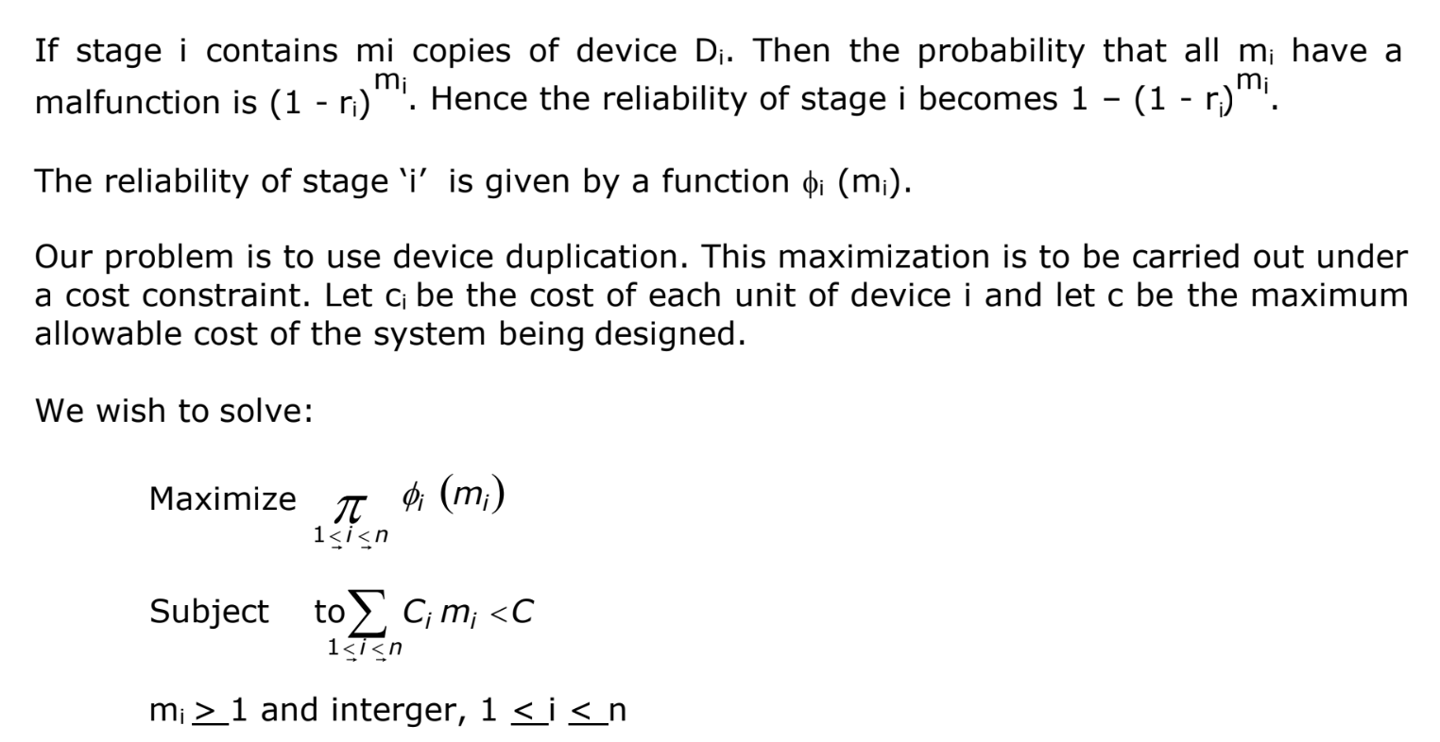

Slide 69
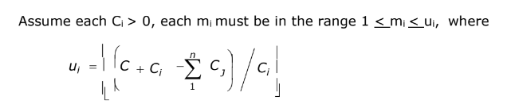
Reliability Design
An optimal solution m1, m2 …........ mn is the result of a sequence of decisions, one decision for each mi.
The dominance rule (f1, x1) dominate (f2, x2) if f1 ≥ f2 and x1 ≤ x2. Hence, dominated tuples can be discarded from S^{i}

Slide 70
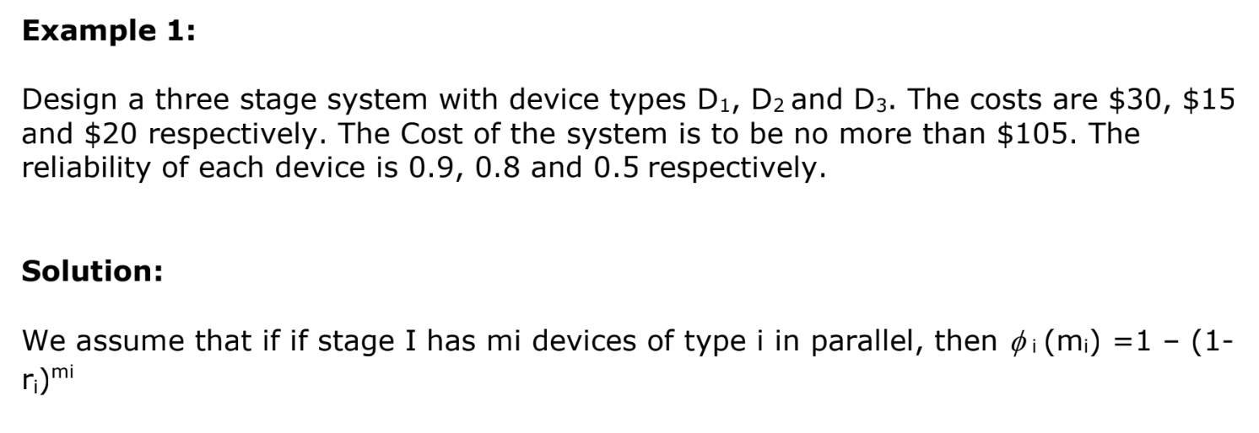

Slide 71
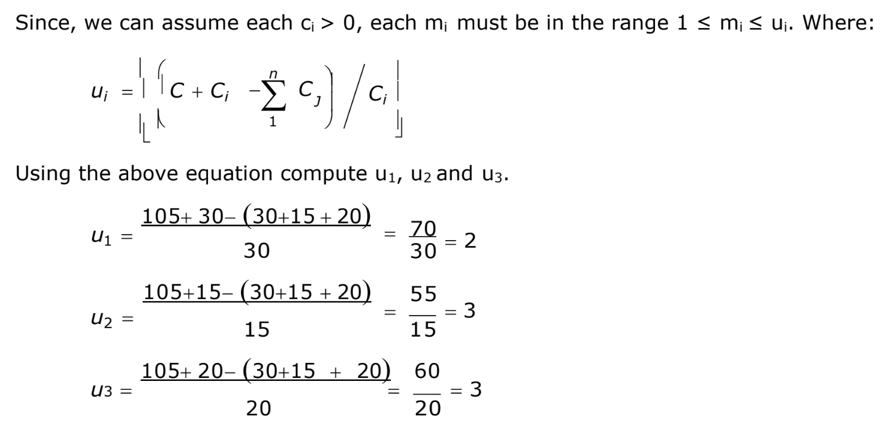

Slide 72
D_{i} | C_{i} | r_{i} | u_{i}
D1 | 30 | 0.9 | 2
D2 | 15 | 0.8 | 3
D3 | 20 | 0.5 | 3

Slide 73
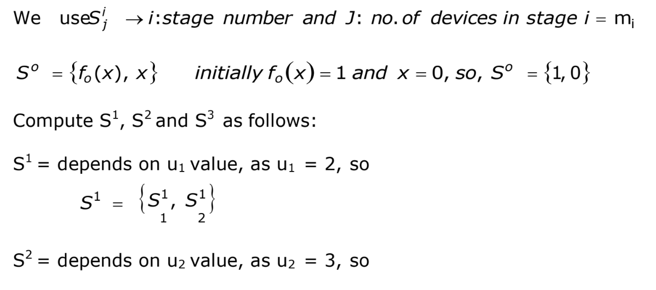

Slide 74
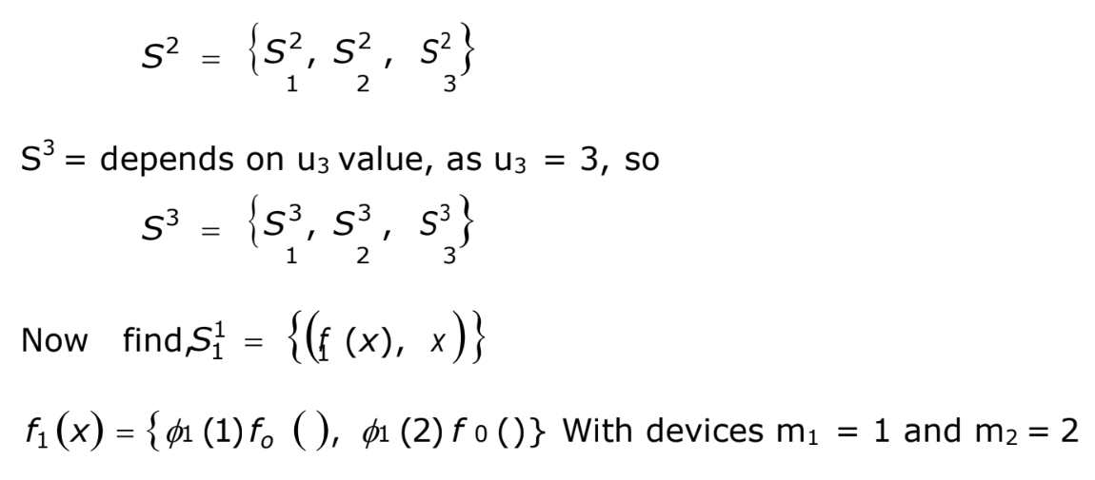

Slide 75
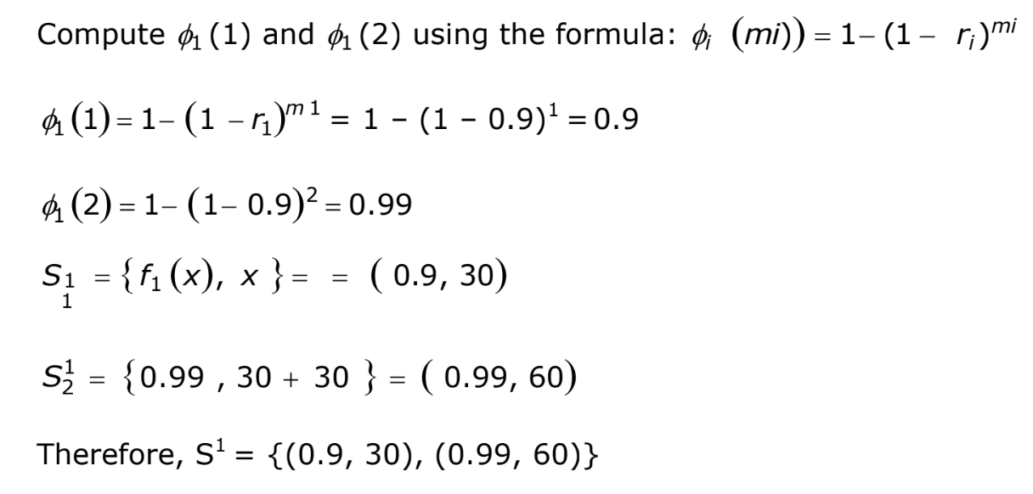

Slide 76
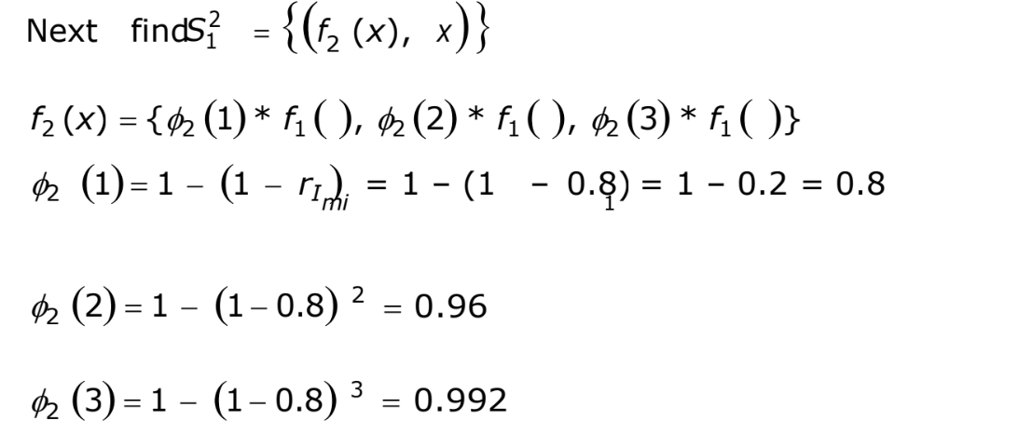

Slide 77
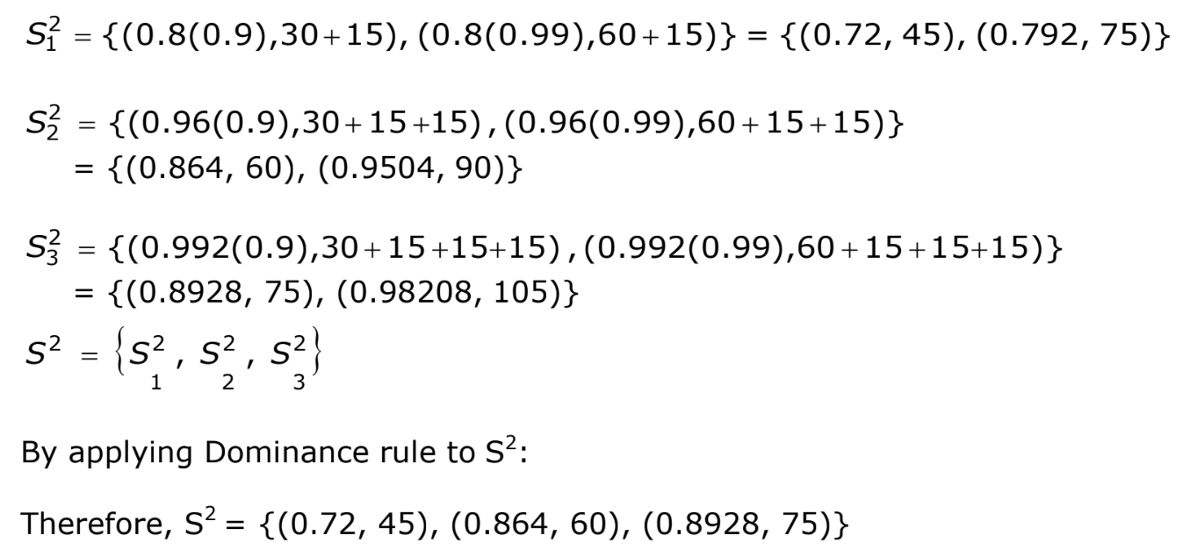

Slide 78
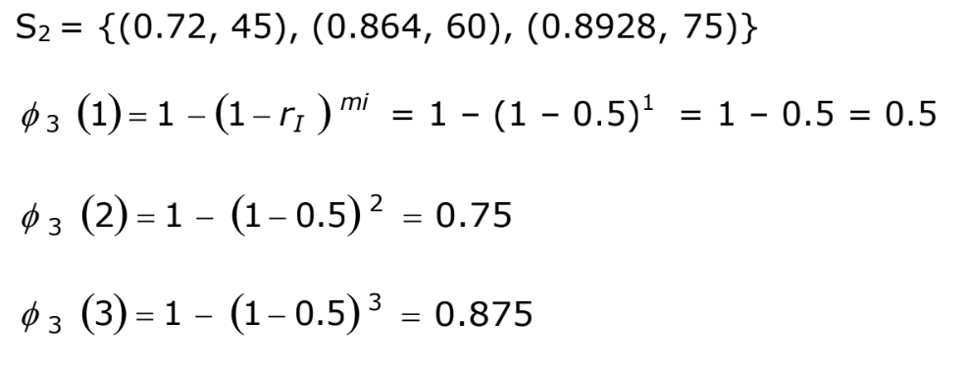

Slide 79
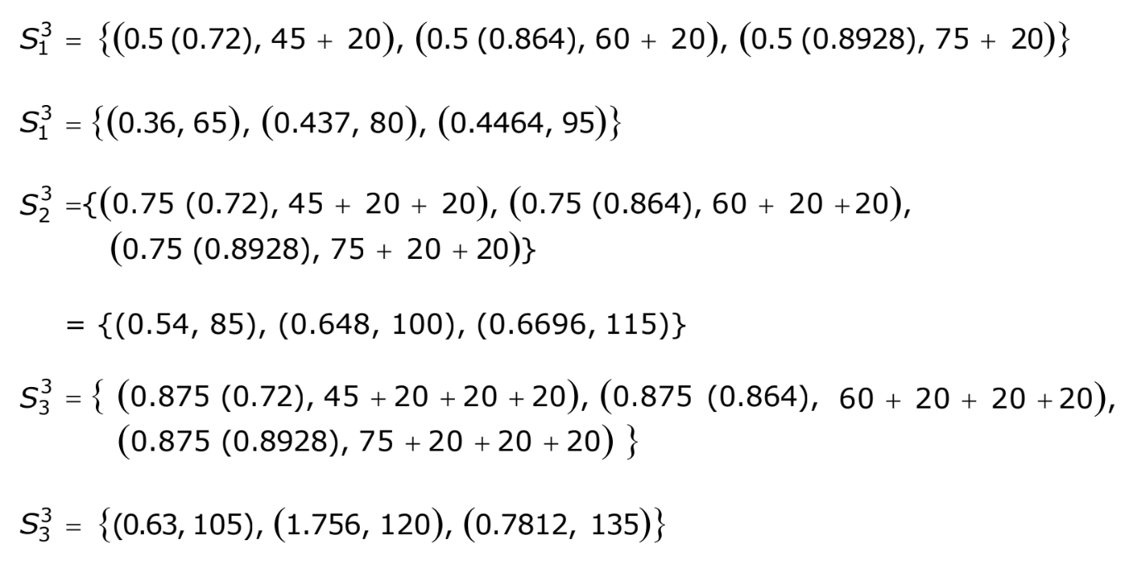

Slide 80
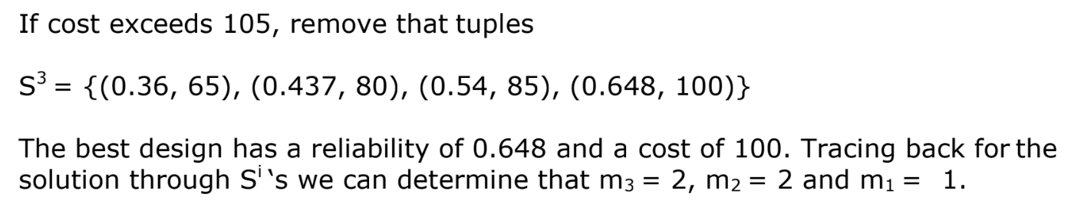

Slide 81
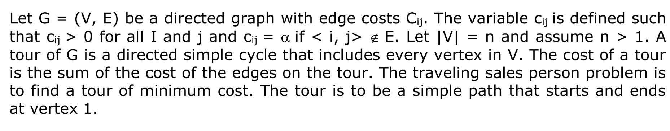
TSP

Slide 82
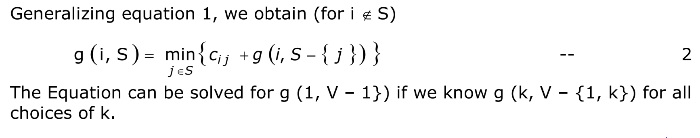

Slide 83
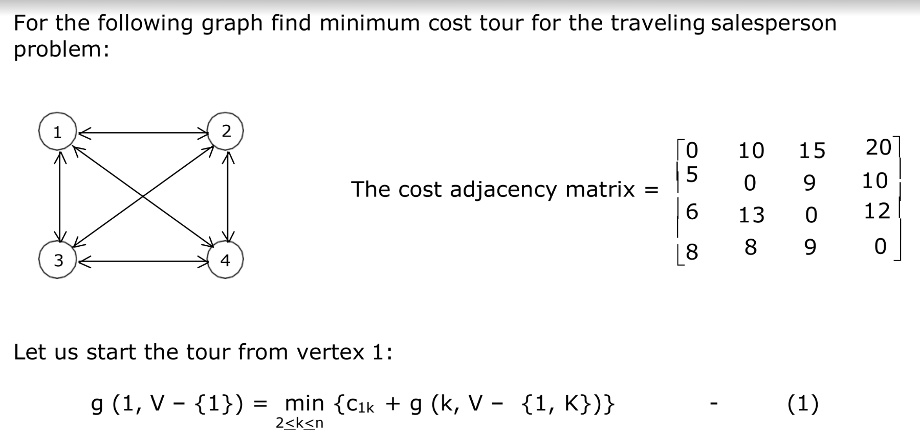

Slide 84
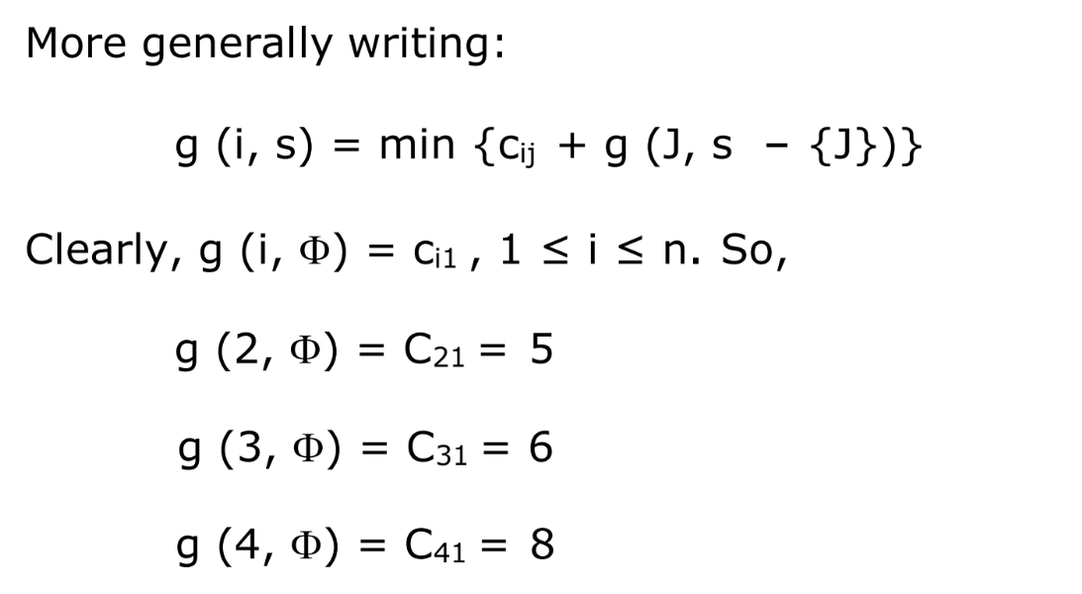

Slide 85
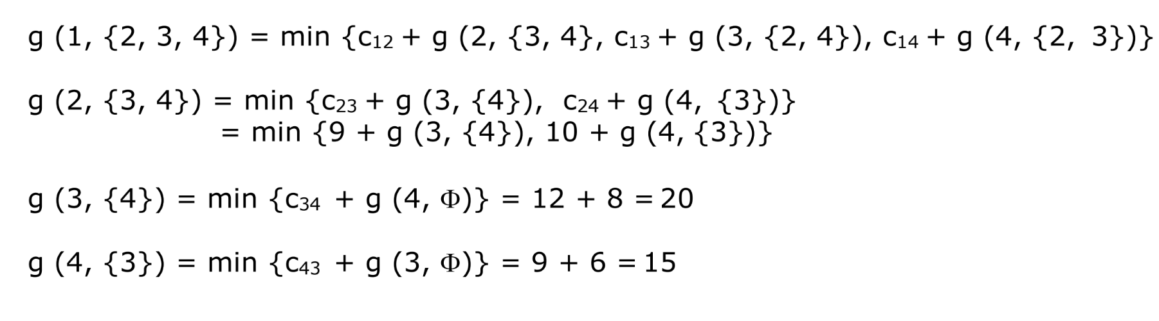

Slide 86
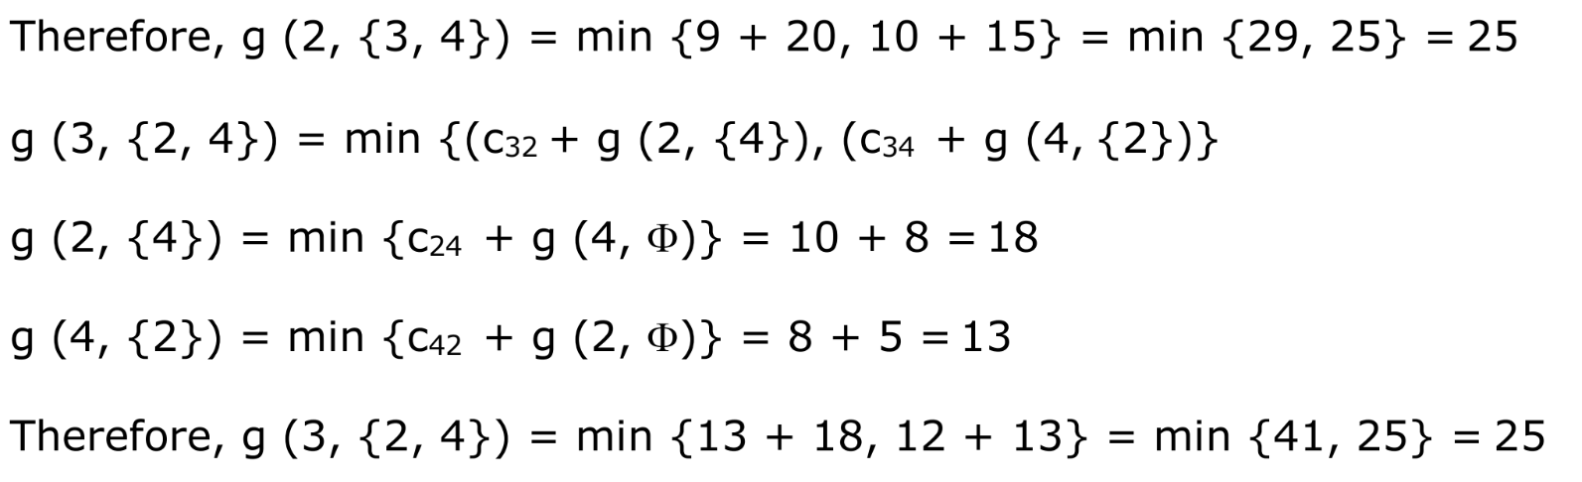

Slide 87
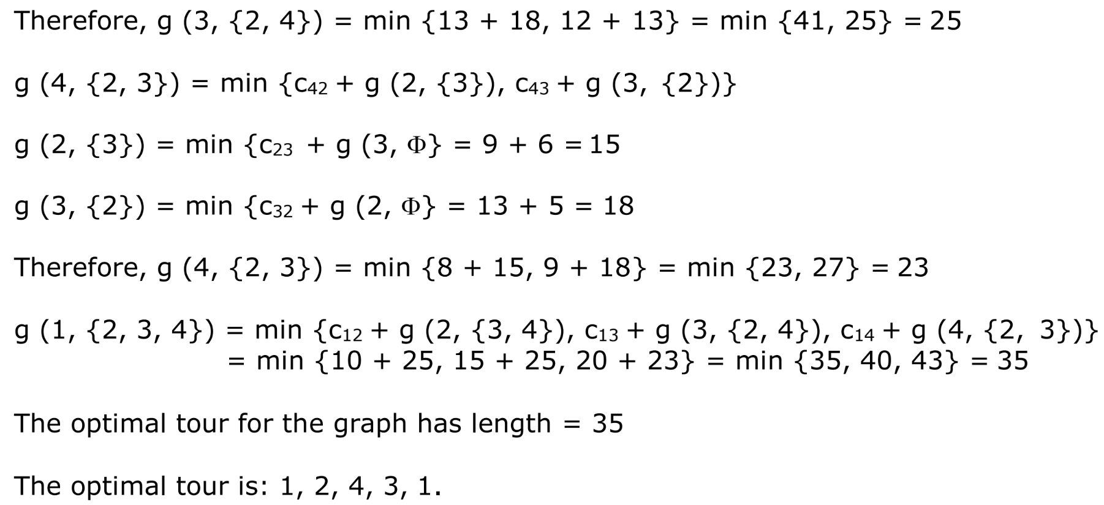

Slide 88
Optimal Binary Search Tree
As we know that in binary search tree, the nodes in the left subtree have lesser value than the root node and the nodes in the right subtree have greater value than the root node.
We know the key values of each node in the tree, and we also know the frequencies of each node in terms of searching means how much time is required to search a node.
The frequency and key-value determine the overall cost of searching a node. The cost of searching is a very important factor in various applications.
The overall cost of searching a node should be less. The time required to search a node in BST is more than the balanced binary search tree as a balanced binary search tree contains a lesser number of levels than the BST.
There is one way that can reduce the cost of a binary search tree is known as an optimal binary search tree.

Slide 89
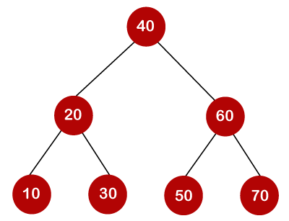
Optimal Binary Search Tree

Slide 90
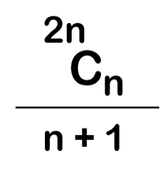
Optimal Binary Search Tree
In the above tree, all the nodes on the left subtree are smaller than the value of the root node, and all the nodes on the right subtree are larger than the value of the root node.
The maximum time required to search a node is equal to the minimum height of the tree, equal to log(n).
Now we will see how many binary search trees can be made from the given number of keys.
For example: 10, 20, 30 are the keys, and the following are the binary search trees that can be made out from these keys.

Slide 91
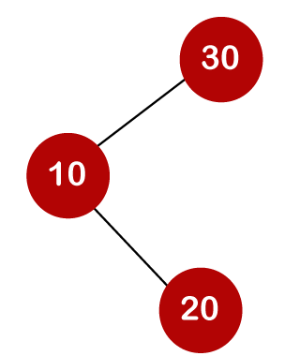
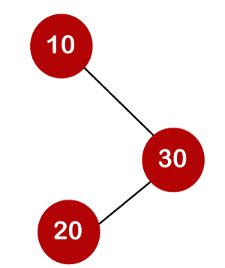
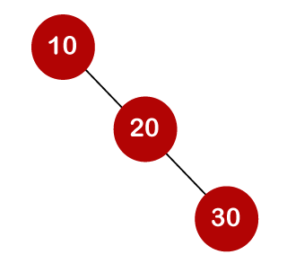
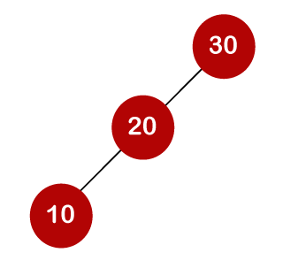
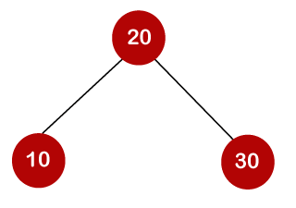
When we use the above formula, then it is found that total 5 number of trees can be created.
The cost required for searching an element depends on the comparisons to be made to search an element. Now, we will calculate the average cost of time of the above binary search trees.

Slide 92
Till now, we read about the height-balanced binary search tree.
To find the optimal binary search tree, we will determine the frequency of searching a key.
Let's assume that frequencies associated with the keys 10, 20, 30 are 3, 2, 5.
The above trees have different frequencies. The tree with the lowest frequency would be considered the optimal binary search tree. The tree with the frequency 17 is the lowest, so it would be considered as the optimal binary search tree.
Keys​ | 10 | 20​ | 30​
Frequency​ | 3 | 2 | 5

Slide 93
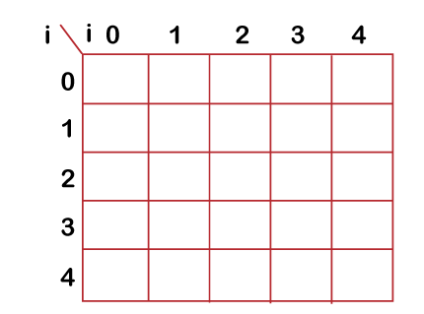
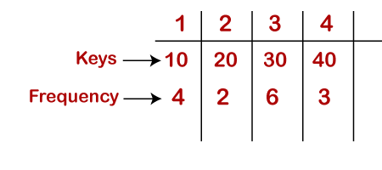
Dynamic Approach Optimal Binary Search Trees
General formula for calculating the minimum cost is:
C[i,j] = min (I<k<=j){c[i, k-1] + c[k,j]} + w(i,j)

Slide 94
First, we will calculate the values where j-i is equal to zero.
When i=0, j=0, then j-i = 0
When i = 1, j=1, then j-i = 0
When i = 2, j=2, then j-i = 0
When i = 3, j=3, then j-i = 0
When i = 4, j=4, then j-i = 0
Therefore, c[0, 0] = 0, c[1 , 1] = 0, c[2,2] = 0, c[3,3] = 0, c[4,4] = 0
Now we will calculate the values where j-i equal to 1.
When j=1, i=0 then j-i = 1
When j=2, i=1 then j-i = 1
When j=3, i=2 then j-i = 1
When j=4, i=3 then j-i = 1

Slide 95
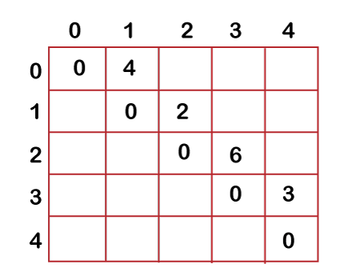
Now to calculate the cost, we will consider only the jth value.
The cost of c[0,1] is 4 (The key is 10, and the cost corresponding to key 10 is 4).
The cost of c[1,2] is 2 (The key is 20, and the cost corresponding to key 20 is 2).
The cost of c[2,3] is 6 (The key is 30, and the cost corresponding to key 30 is 6)
The cost of c[3,4] is 3 (The key is 40, and the cost corresponding to key 40 is 3)

Slide 96

Now we will calculate the values where j-i = 2
When j=2, i=0 then j-i = 2
When j=3, i=1 then j-i = 2
When j=4, i=2 then j-i = 2
In this case, we will consider two keys.
When i=0 and j=2, then keys 10 and 20. There are two possible trees that can be made out from these two keys shown below:

Slide 97

In the first binary tree, cost would be: 4*1 + 2*2 = 8
In the second binary tree, cost would be: 4*2 + 2*1 = 10
The minimum cost is 8; therefore, c[0,2] = 8

Slide 98
When i=1 and j=3, then keys 20 and 30. There are two possible trees that can be made out from these two keys shown below:
In the first binary tree, cost would be: 1*2 + 2*6 = 14
In the second binary tree, cost would be: 1*6 + 2*2 = 10
The minimum cost is 10; therefore, c[1,3] = 10
When i=2 and j=4, we will consider the keys at 3 and 4, i.e., 30 and 40. There are two possible trees that can be made out from these two keys shown as below:
In the first binary tree, cost would be: 1*6 + 2*3 = 12
In the second binary tree, cost would be: 1*3 + 2*6 = 15
The minimum cost is 12, therefore, c[2,4] = 12

Slide 99


Slide 100

Now we will calculate the values when j-i = 3
When j=3, i=0 then j-i = 3
When j=4, i=1 then j-i = 3
When i=0, j=3 then we will consider three keys, i.e., 10, 20, and 30.
The following are the trees that can be made if 10 is considered as a root node.
In the above tree, 10 is the root node, 20 is the right child of node 10, and 30 is the right child of node 20.
Cost would be: 1*4 + 2*2 + 3*6 = 26

Slide 101

In the above tree, 10 is the root node, 30 is the right child of node 10, and 20 is the left child of node 20.
Cost would be: 1*4 + 2*6 + 3*2 = 22

Slide 102

In the above tree, 20 is the root node, 30 is the right child of node 20, and 10 is the left child of node 20.
Cost would be: 1*2 + 4*2 + 6*2 = 22

Slide 103

In the above tree, 30 is the root node, 20 is the left child of node 30, and 10 is the left child of node 20.
Cost would be: 1*6 + 2*2 + 3*4 = 22

Slide 104

In the above tree, 30 is the root node, 10 is the left child of node 30 and 20 is the right child of node 10.
Cost would be: 1*6 + 2*4 + 3*2 = 20
Therefore, the minimum cost is 20 which is the 3rd root. So, c[0,3] is equal to 20.

Slide 105

When i=1 and j=4 then we will consider the keys 20, 30, 40
c[1,4] = min{ c[1,1] + c[2,4], c[1,2] + c[3,4], c[1,3] + c[4,4] } + 11
= min{0+12, 2+3, 10+0}+ 11
= min{12, 5, 10} + 11
The minimum value is 5; therefore, c[1,4] = 5+11 = 16

Slide 106
Now we will calculate the values when j-i = 4
When j=4 and i=0 then j-i = 4
In this case, we will consider four keys, i.e., 10, 20, 30 and 40. The frequencies of 10, 20, 30 and 40 are 4, 2, 6 and 3 respectively.
w[0, 4] = 4 + 2 + 6 + 3 = 15
If we consider 10 as the root node then
C[0, 4] = min {c[0,0] + c[1,4]}+ w[0,4] = min {0 + 16} + 15= 31
If we consider 20 as the root node then
C[0,4] = min{c[0,1] + c[2,4]} + w[0,4] = min{4 + 12} + 15 = 16 + 15 = 31
If we consider 30 as the root node then,
C[0,4] = min{c[0,2] + c[3,4]} +w[0,4] = min {8 + 3} + 15 = 26
If we consider 40 as the root node then,
C[0,4] = min{c[0,3] + c[4,4]} + w[0,4] = min{20 + 0} + 15 = 35

Slide 107


Slide 108


Slide 109


Slide 110


